Slide 1

GPU ACCELERATED DEEP LEARNING
WITH CUDNN
Larry Brown Ph.D.
March 2015

Slide 2









2
1 | Introducing cuDNN and GPUs
2 | Deep Learning Context
3 | cuDNN V2
4 | Using cuDNN
AGENDA

Slide 3


Introducing cuDNN and GPUs
3

Slide 4












HOW GPU ACCELERATION WORKS
4
Application Code
Compute-Intensive Functions
Rest of Sequential
CPU Code
5% of Code
~ 80% of run-time
GPU
CPU
+

Slide 5










WHAT IS CUDNN?
cuDNN is a library of primitives for deep learning
Applications
Programming
Languages
Libraries
OpenACC
Directives
Maximum Flexibility
“Drop-in” Acceleration
Easily Accelerate Applications

Slide 6
ANALOGY TO HPC
cuDNN is a library of primitives for deep learning
Application
Fluid Dynamics Computational Physics
BLAS standard interface
Various CPU BLAS implementations
cuBLAS/NVBLAS
Intel CPUs
IBM Power
Tesla Titan
TK1 TX1

Slide 7




DEEP LEARNING WITH CUDNN
cuDNN is a library of primitives for deep learning
Frameworks
Applications
cuDNN
Tesla
TX-1
GPUs
Titan

Slide 8
ANNOUNCING CUDNN V2
cuDNN V2 is focused on …
Performance and, Features
… for the deep learning practitioner!
Optimized for current and future GPUs

Slide 9

Deep Learning Context
9

Slide 10

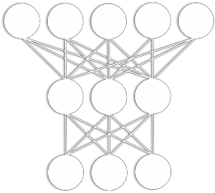







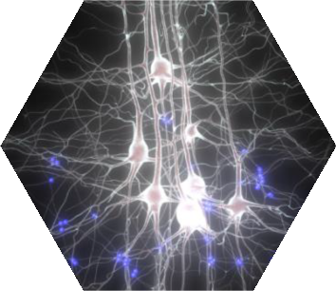


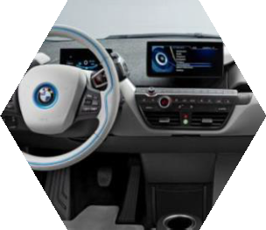
ACCELERATING MACHINE LEARNING
CUDA for Deep Learning
“Machine Learning” is in some sense a rebranding of AI.
The focus is now on more specific, often perceptual tasks, and there are many successes.
Today, some of the world’s largest internet companies, as well as the foremost research institutions, are using GPUs for machine learning.

Slide 11


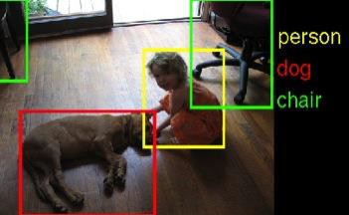
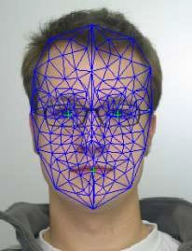
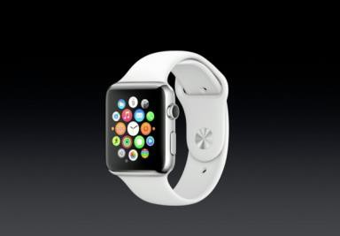

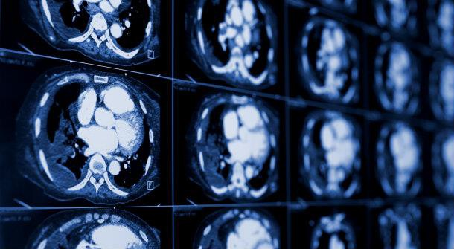
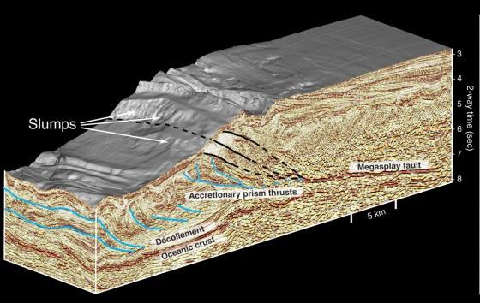
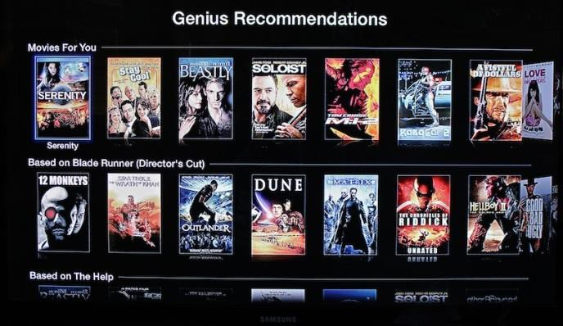
MACHINE LEARNING USE CASES
…machine learning is pervasive
Image Classification, Object Detection, Localization
Speech & Natural Language Processing
Face Recognition
Medical Imaging & Interpretation
Seismic Imaging & Interpretation
Recommendation

Slide 12





WHY IS DEEP LEARNING HOT NOW?
THREE DRIVING FACTORS…
1 - Big Data Availability
350 millions images uploaded per day
2.5 Petabytes of customer data hourly 100 hours of video uploaded every minute
- New ML Techniques
Deep Neural Networks
- Compute Density
GPUs
ML systems extract value from Big Data
12

Slide 13
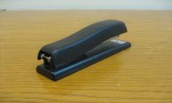
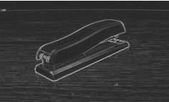

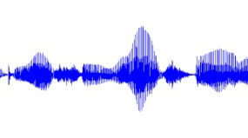
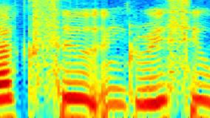


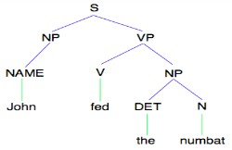
DIFFERENT MODALITIES…SAME APPROACH
Images/video
Image
Vision features
Detection
Audio
Audio
Audio features
Speaker ID
Text classification, Machine translation, Information retrieval, ....
Text
Text
Text features
Slide courtesy of Andrew Ng, Stanford University
13

Slide 14









DEEP LEARNING ADVANTAGES
Deep Learning
Don’t have to figure out the features ahead of time!
Use same neural net approach for many different problems.
Fault tolerant.
Scales well.
Support Vector Machine
Bayesian
Linear classifier
Clustering
Regression Decision Trees
Association Rules

Slide 15

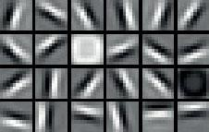
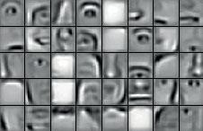
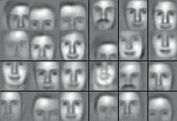






































































































































WHAT IS DEEP LEARNING?
Today’s Largest Networks
~10 layers
1B parameters 10M images
~30 Exaflops
~30 GPU days
Human brain has trillions of parameters – only 1,000 more.
Input
Result

Slide 16
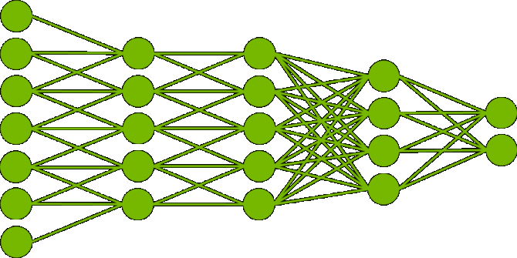

CLASSIFICATION WITH DNNS
Training (Development)
Inference
(Production)
cars
buses
trucks
motorcycles
truck

Slide 17
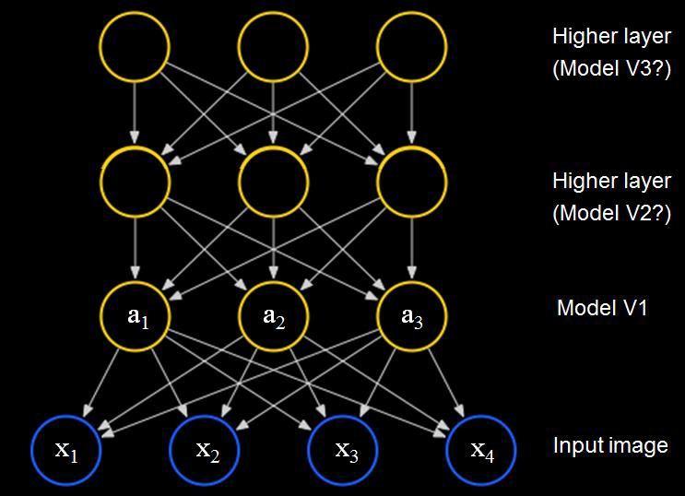

WHY ARE GPUS GREAT FOR DEEP LEARNING?
 | Neural Networks | GPUs
Inherently Parallel | ✓ | ✓
Matrix Operations | ✓ | ✓
FLOPS | ✓ | ✓
GPUs deliver --
same or better prediction accuracy
faster results
smaller footprint lower power
[Lee, Ranganath & Ng, 2007]

Slide 18
CONVOLUTIONAL NEURAL NETWORKS
Biologically inspired.
Neuron only connected to a small region of neurons in layer below it called the filter or receptive field.
A given layer can have many convolutional filters/kernels. Each filter has the same weights across the whole layer.
Bottom layers are convolutional, top layers are fully connected.
Generally trained via supervised learning.

Slide 19


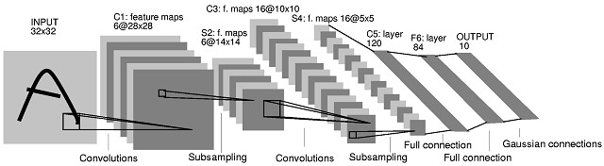
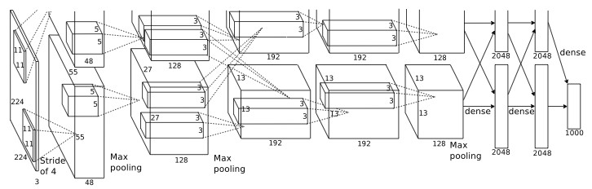
CONVOLUTIONAL NET EXAMPLES
19
Y. LeCun et al. 1989-1998 : Handwritten digit reading
CONVOLUTIONAL NETWORKS
BREAKTHROUGH
A. Krizhevsky, G. Hinton et al. 2012 : Imagenet classification winner

Slide 20
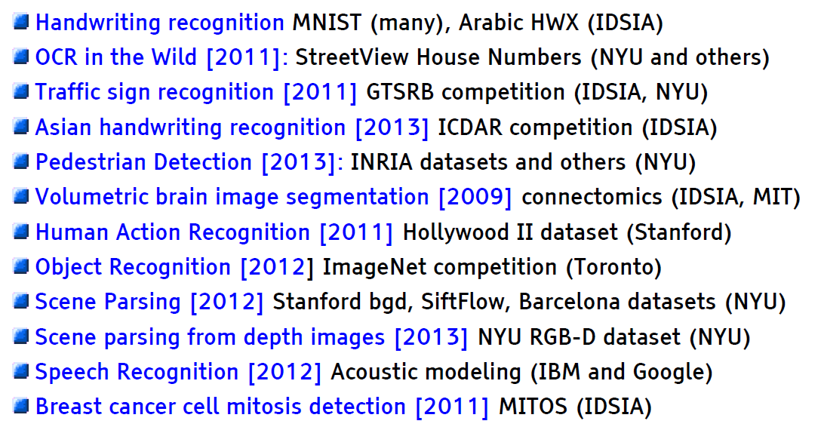
CNNS DOMINATE IN PERCEPTUAL TASKS
Slide credit: Yann Lecun, Facebook & NYU
20

Slide 21


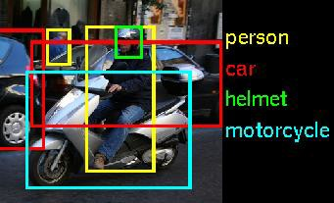
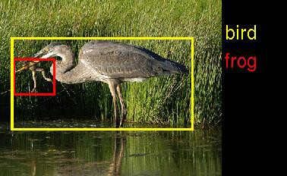
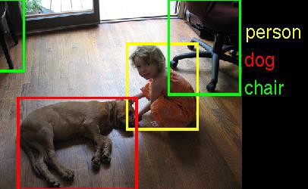
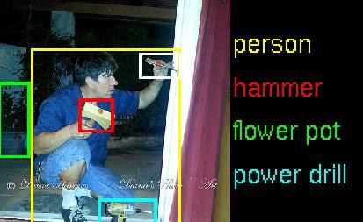
GPUS – THE PLATFORM FOR MACHINE LEARNING
Image Recognition Challenge
1.2M training images • 1000 object categories
GPU Entries
120
100
80
60
40
20
0
 |  |  | 110
 | 60
4
Hosted by
2010
2011
2012
2013
2014
person car helmet
bird frog
Classification Error Rates
30%
25%
20%
15%
10%
5%
0%
28%
motorcycle
26%
person hammer
16%
person
12%
dog chair
flower pot
power drill
7%
2010 2011 2012 2013 2014

Slide 22
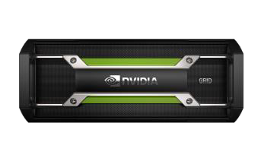
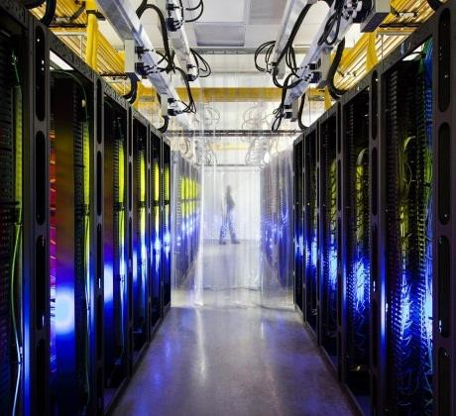


GPUS MAKE DEEP LEARNING ACCESSIBLE
Deep learning with COTS HPC systems
Coates, B. Huval, T. Wang, D. Wu,
Ng, B. Catanzaro
ICML 2013
GOOGLE DATACENTER
1,000 CPU Servers 600 kWatts 2,000 CPUs • 16,000 cores _{$5,000,000}
STANFORD AI LAB
“Now You Can Build Google’s
$1M Artificial Brain on the Cheap
“
3 GPU-Accelerated Servers
12 GPUs • 18,432 cores
4 kWatts
$33,000

Slide 23


version 2
23
cuDNN

Slide 24
CUDNN DESIGN GOALS
Basic Deep Learning Subroutines
Allow user to write a DNN application without any custom CUDA code
Flexible Layout
Handle any data layout
Memory – Performance tradeoff
Good performance with minimal memory use, great performance with more memory use

Slide 25
CUDNN ROUTINES
Convolutions – 80-90% of the execution time Pooling - Spatial smoothing
Activation - Pointwise non-linear function

Slide 26
CONVOLUTIONS – THE MAIN WORKLOAD
Very compute intensive, but with a large parameter space
Minibatch Size
Input feature maps
Image Height
Image Width
Output feature maps
Kernel Height
Kernel Width
Top zero padding
Side zero padding
Vertical stride
Horizontal stride
Layout and configuration variations
Other cuDNN routines have straightforward implementations

Slide 27
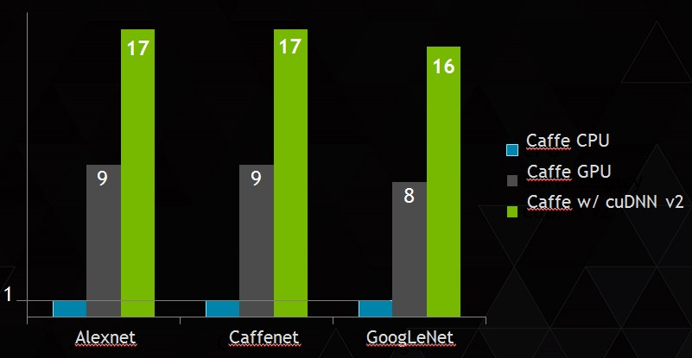
CUDNN V2
- PERFORMANCE
CPU is 16 core Haswell E5-2698 at 2.3 GHz, with 3.6 GHz Turbo
GPU is NVIDIA Titan X

Slide 28
CUDNN V2 FLEXIBILITY
Can now specify a strategy the library will use to select the best convolution algorithm:
PREFER_FASTEST NO_WORKSPACE SPECIFY_WORKSPACE_LIMIT
…or specify an algorithm directly…
GEMM IMPLICIT_GEMM
IMPLICIT_PRECOMP_GEMM DIRECT

Slide 29
CUDNN V2 NEW FEATURES
Other key new features:
Support for 3D datasets. Community feedback desired!
OS X support
Zero-padding of borders in pooling routines
Parameter scaling
Improved support for arbitrary strides
Support for upcoming Tegra X1 via JIT compilation
See Release Notes for details…

Slide 30
CUDNN V2 API CHANGES
Important – API Has Changed
Several of the new improvements required changes to the cuDNN API.
Applications previously using cuDNN V1 are likely to need minor modifications.
Note Im2Col function is currently exposed public function…but will be removed.
The cuDNN team genuinely appreciates all feedback from the Deep learning community.
The team carefully considers any API change.
cuDNN is still young…API changes expected to become rare in the future.

Slide 31
Using cuDNN
31

Slide 32
CUDNN EASY TO ENABLE
Install cuDNN on your system
Install cuDNN on your system
Download CAFFE
Install Torch as usual
In CAFFE Makefile.config
Install cudnn.torch
module
uncomment
USE_CUDNN := 1
Use cudnn module in Torch instead
of regular nn module.
Install CAFFE as usual
Use CAFFE as usual.
cudnn module is API compatable with standard nn module.
Replace nn with cudnn
CUDA 6.5 or newer required

Slide 33
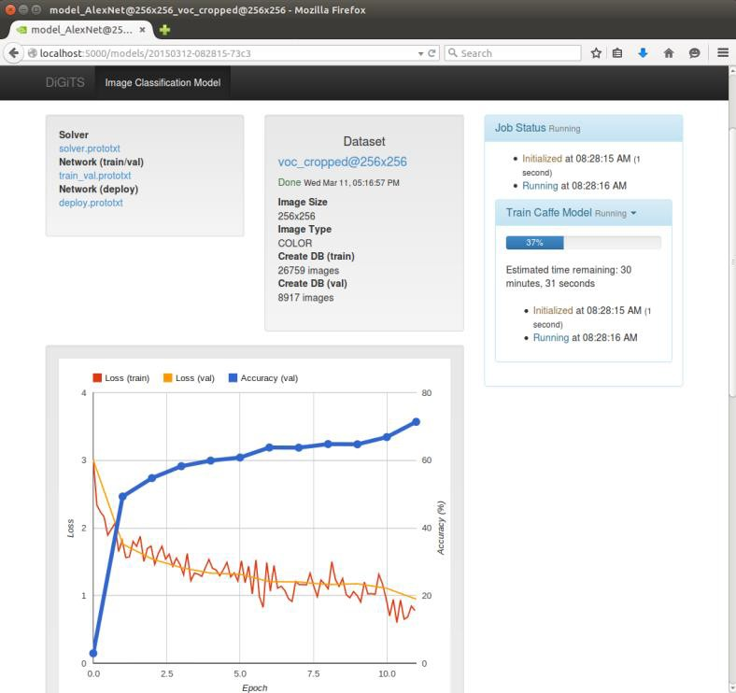
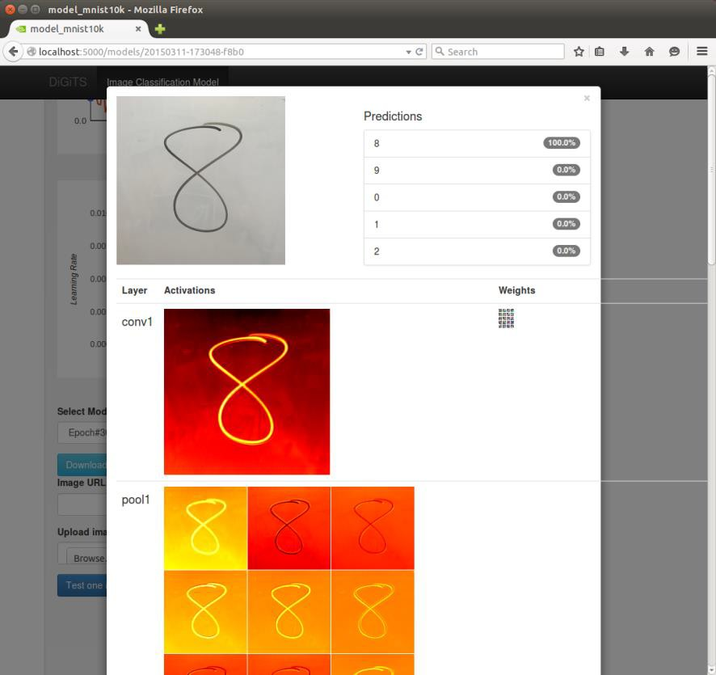
DIGITS
Interactive Deep Learning GPU Training System
Data Scientists & Researchers:
Quickly design the best deep neural network (DNN) for your data
Visually monitor DNN training quality in real-time
Manage training of many DNNs in
parallel on multi-GPU systems
developer.nvidia.com/digits

Slide 34

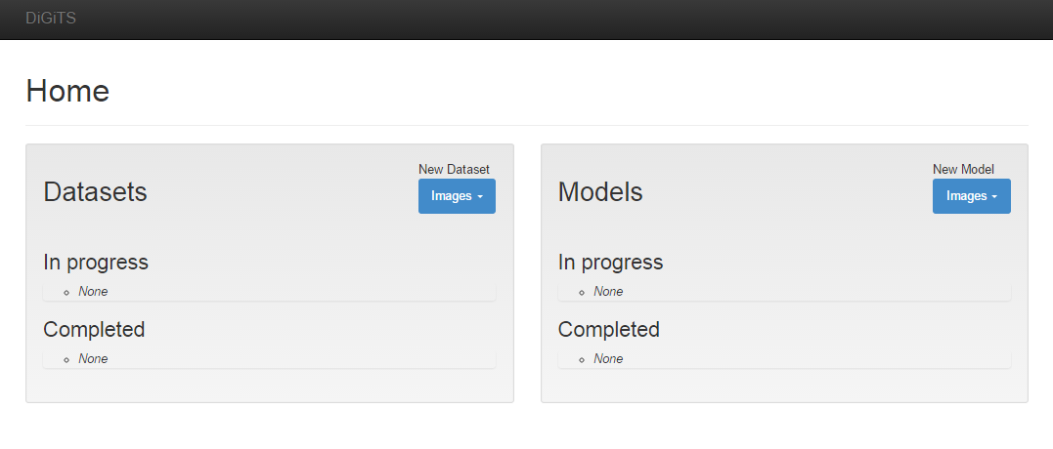
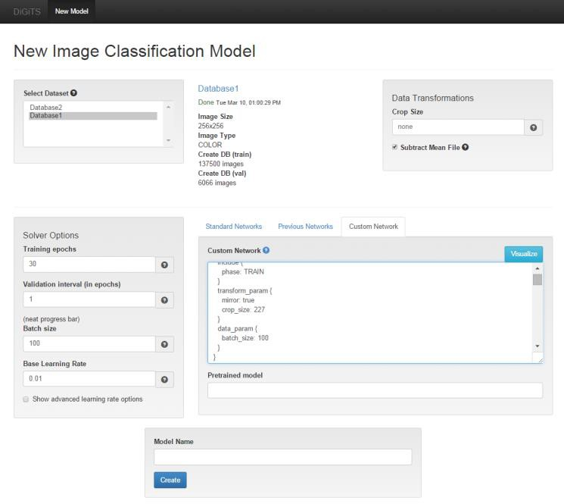
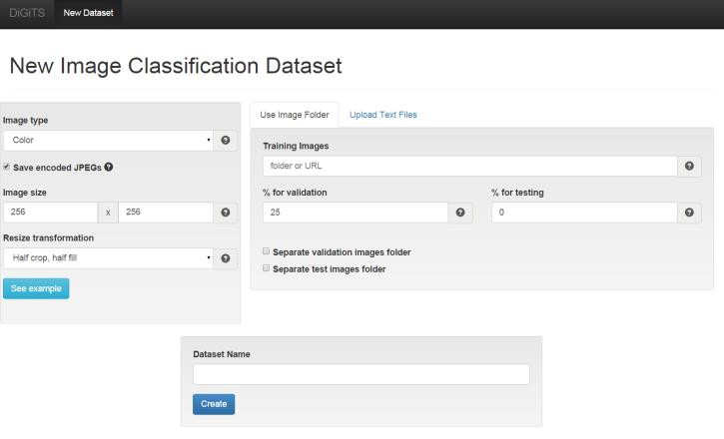
DIGITS Workflow
34
Main Console
Configure your Network
Create your database
Configure your model
Create your dataset
Start training
Choose your database
Start Training
Choose a default network, modify one, or create your own

Slide 35

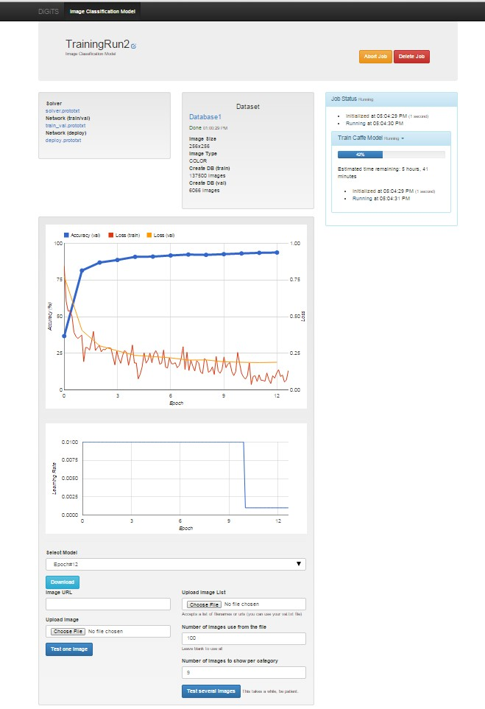
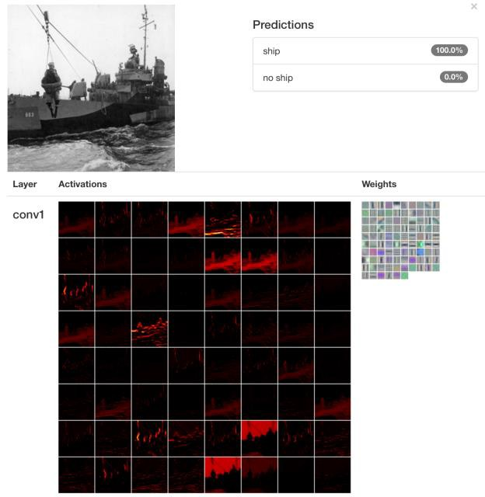
DIGITS
Visualize DNN performance in real time Compare networks
35
Download
network files
Training status
Classification
Accuracy and loss values during training
Learning rate
Classification on the with the network snapshots

Slide 36
developer.nvidia.com/cuDNN
Try it today!

